Slide 1
JIRA - IssueS & Project Tracking TOOL INTRODUCTION

Slide 2

AGENDA
WHAT IS JIRA?
WHY JIRA?
JIRA FEATURES
JIRA AND YOUR PROJECT
HOW TO CREATE JIRA ISSUES
Q&A

Slide 3

WHAT IS JIRA?
ISSUE TRACKING
PROJECT MANAGEMENT
BUG TRACKING
MANAGING AND TRACKING DEVELOPMENT EFFORTS

Slide 4

ADVANTAGES OF JIRA
CUSTOMIZATION
WORKFLOWS
RELEASES
REPORTING
USABILITY
FLEXIBILITY

Slide 5








JIRA issue types
EPIC
STORY
TASK
SUBTASK
BUG
IMPROVEMENT
CLARIFICATION
TEST

Slide 6
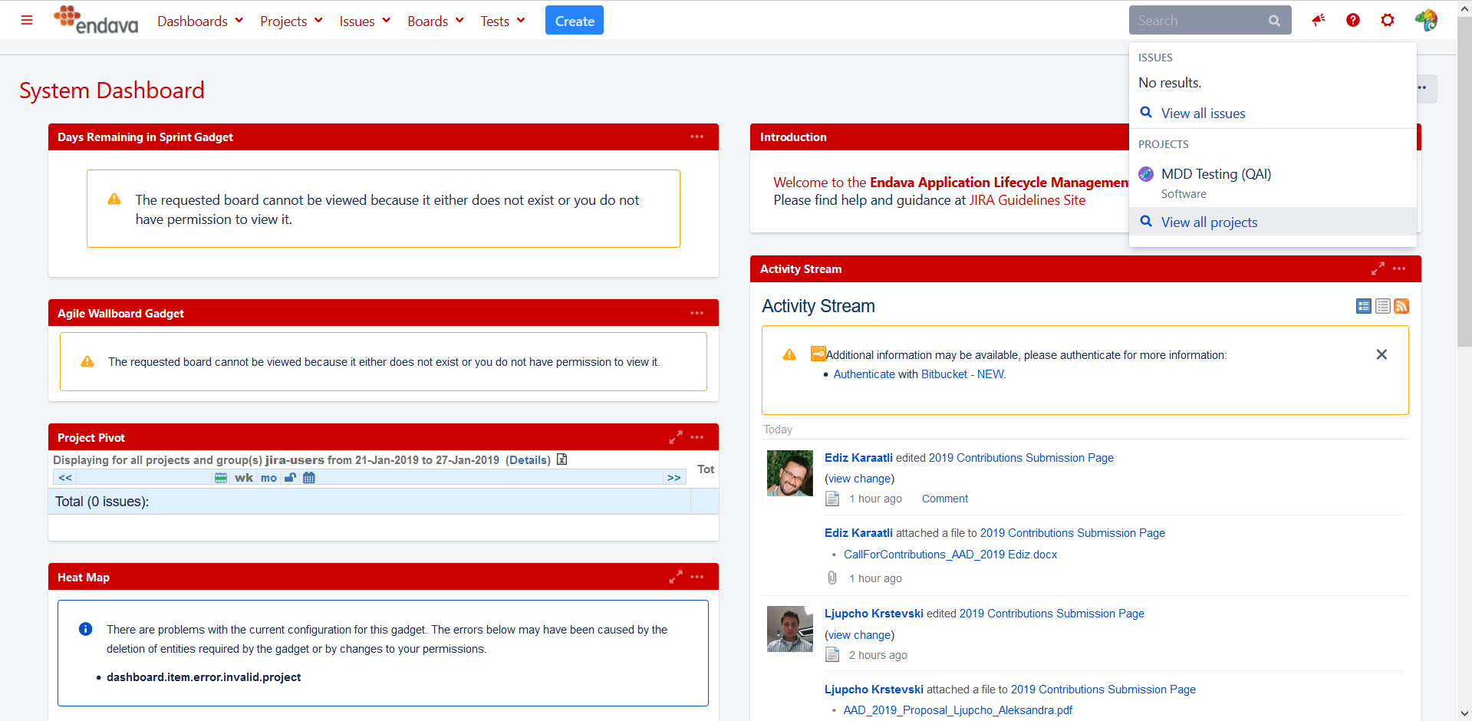
JIRA MAIN PAGE

Slide 7
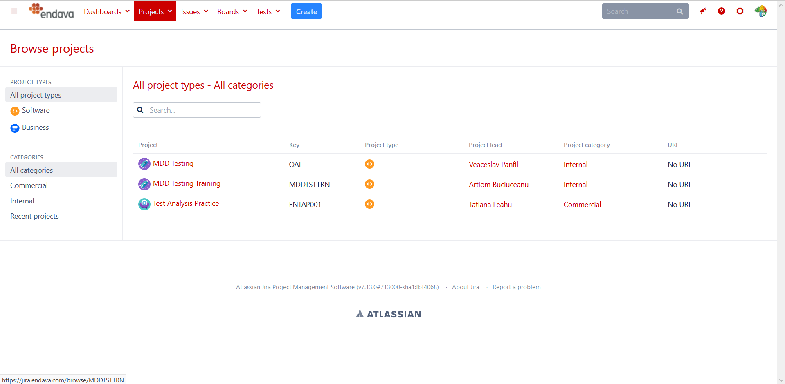
JIRA PROJECTS

Slide 8
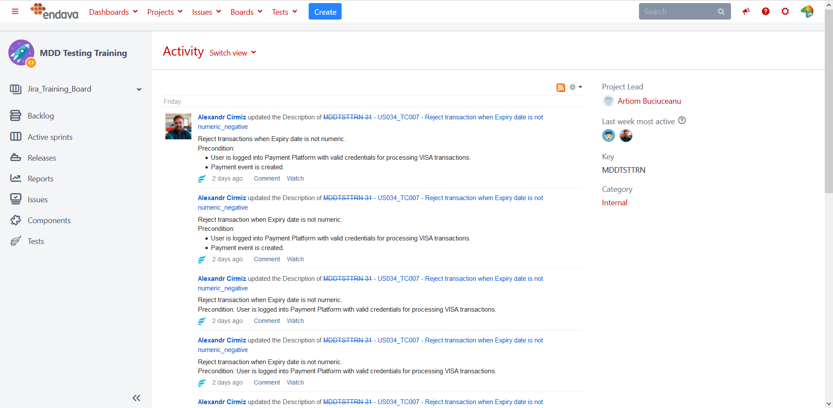
PROJECT PAGE

Slide 9
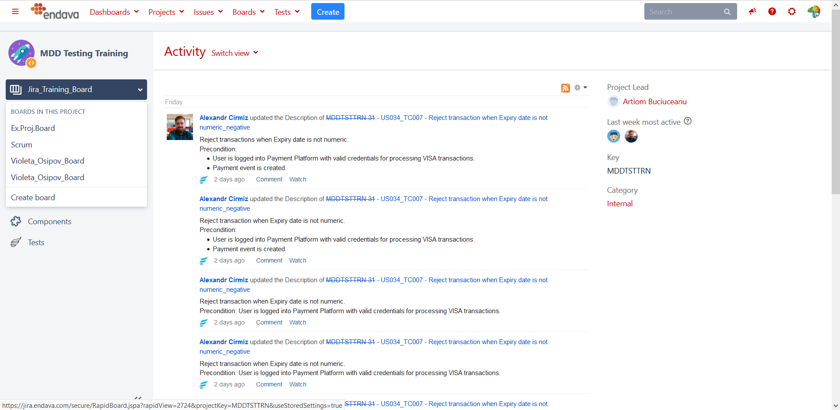
SELECT A BOARD

Slide 10
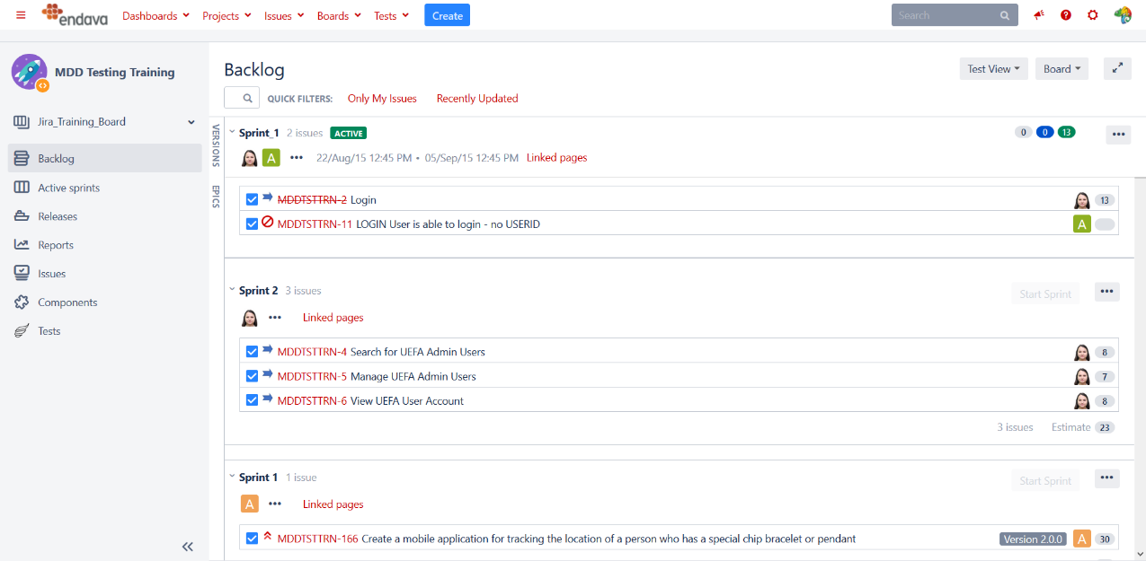
BACKLOG

Slide 11
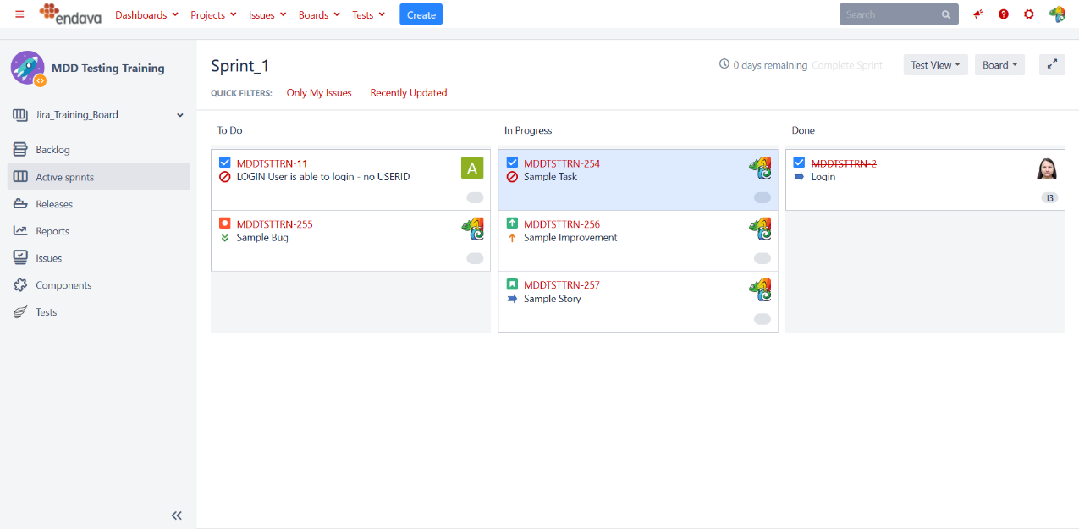
ACTIVE SPRINTS

Slide 12
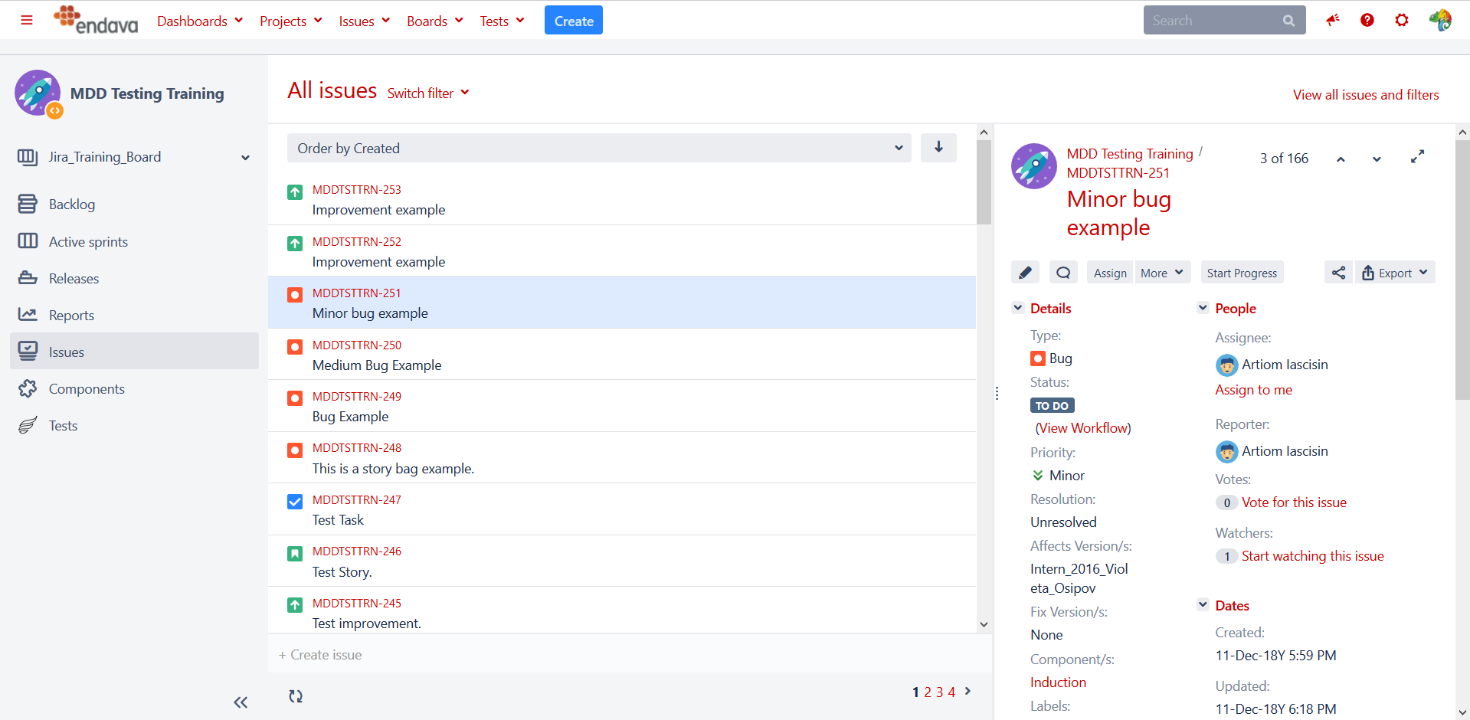
ALL ISSUES PAGE

Slide 13
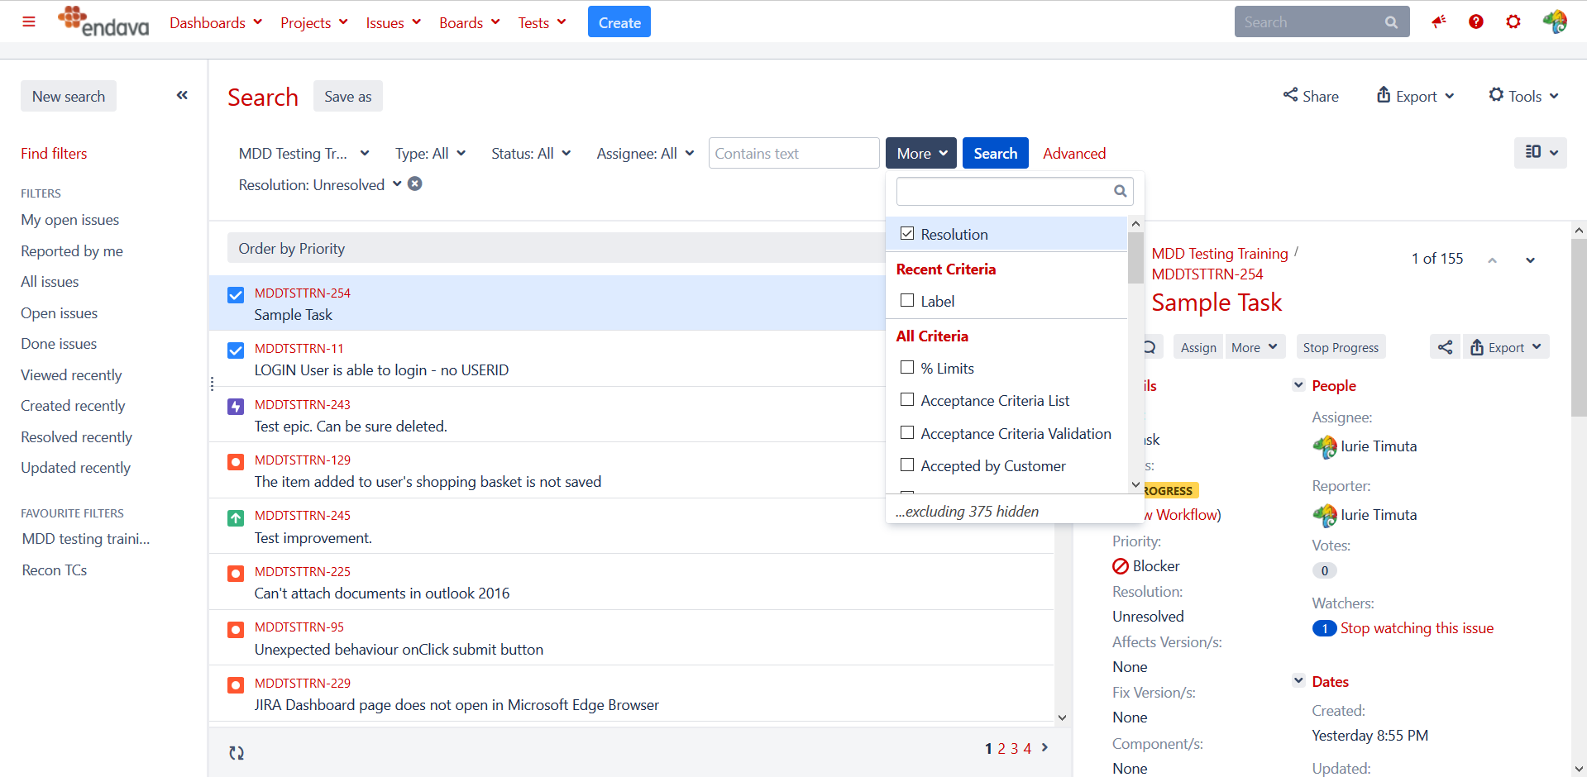
ADVANCED SEARCH

Slide 14
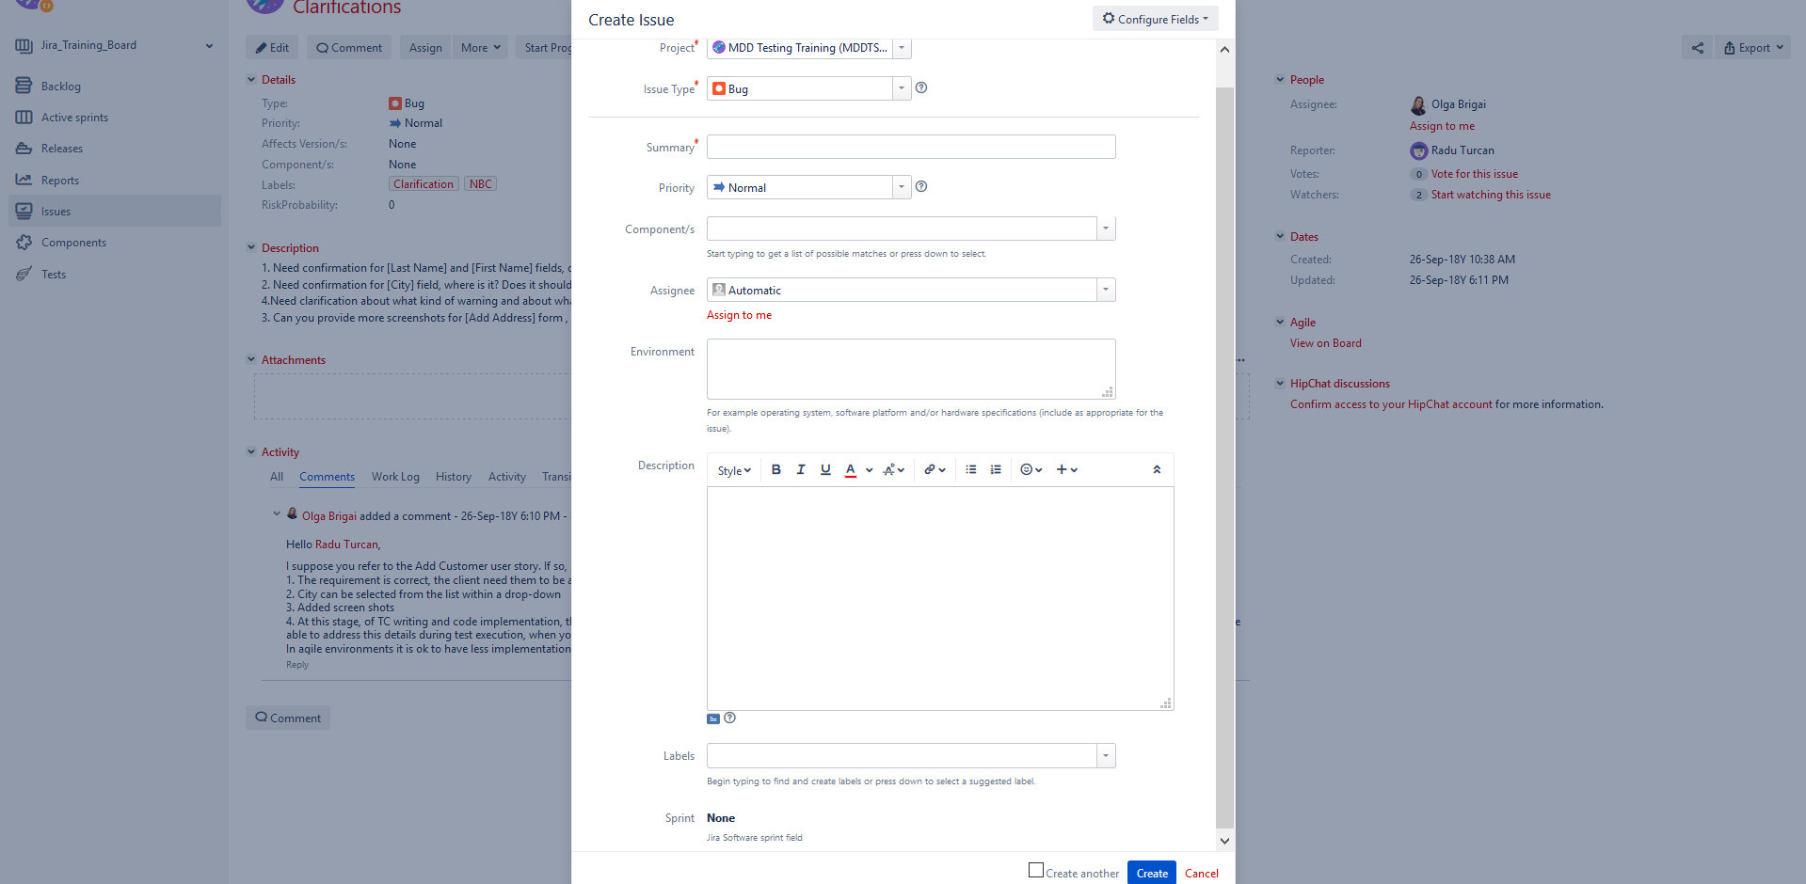
CREATE ISSUE

Slide 15
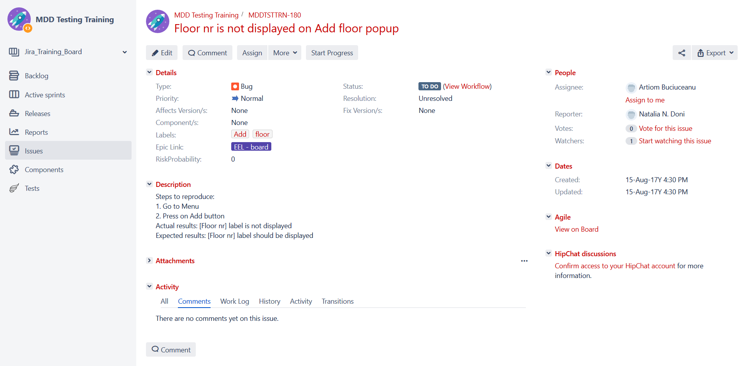
ISSUE DETAILS PAGE

Slide 16

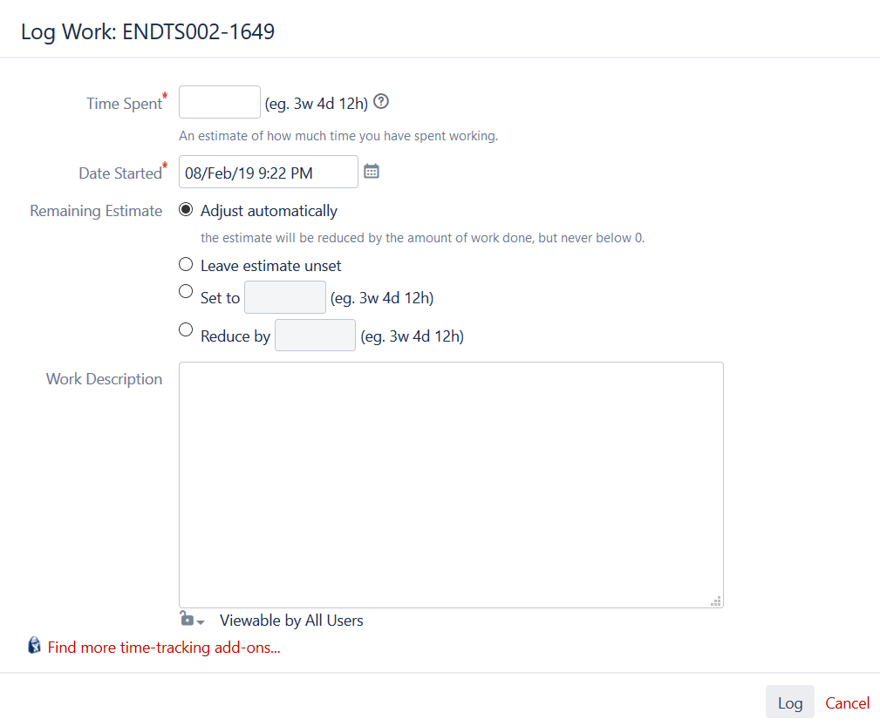
WORK LOG

Slide 17
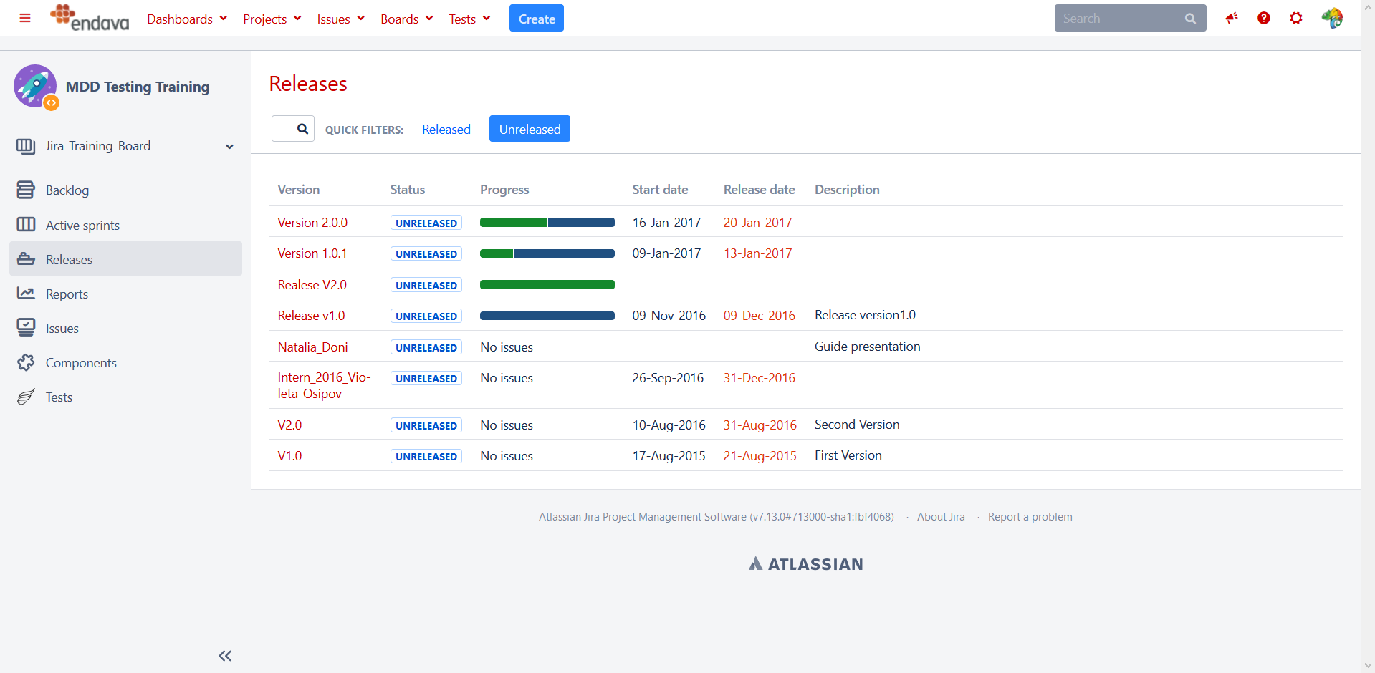
RELEASES

Slide 18
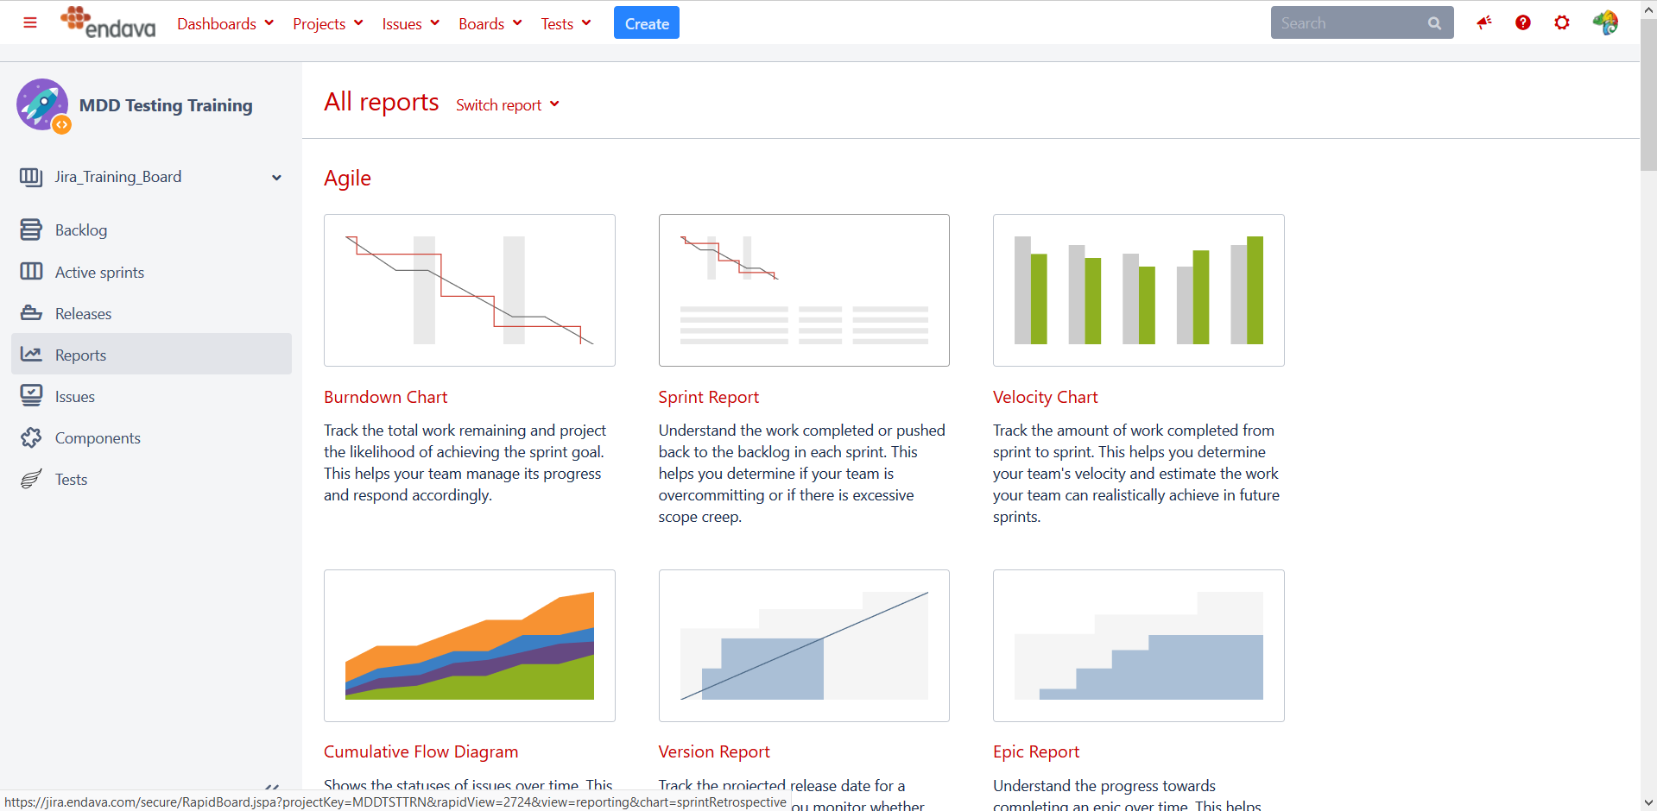
REPORTS

Slide 19

WORKSHOP SESSION

Slide 20
SUMMARY
JIRA TOOL
ISSUE TYPES
PROJECT
BOARD
BACKLOG
SPRINT
ISSUE LIFE CYCLE
ISSUE CREATION
SEARCH
RELEASES
REPORTS

Slide 21
Q&A
?
?
?
?

Slide 22

THANK YOU!

